Slide 1
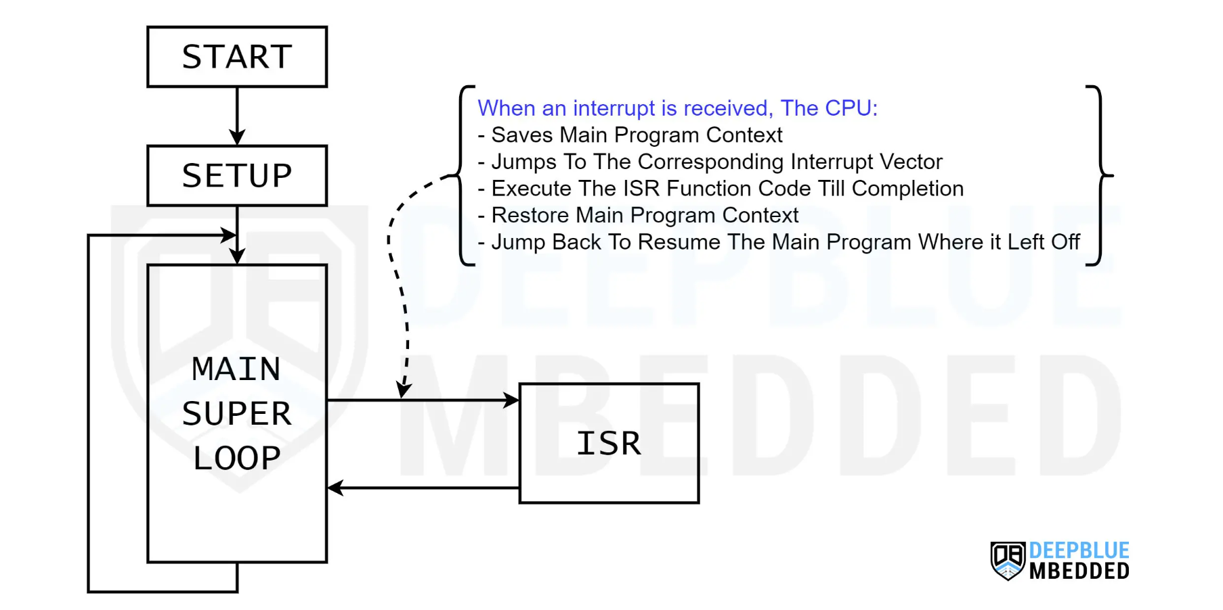
How Interrupts Work
Notes:
We need to temporarily interrupt the current task to perform other tasks.
When the microcontroller’s CPU receives an interrupt signal, it pauses the main program execution and saves its current context.
ISR (interrupt service routine) handlers as quick as possible.

Slide 2
Types of Interrupts
Software & Hardware Interrupts:
Software interrupts are interrupt signals that can be fired with specific software instructions. Some microcontrollers support native software interrupt instructions while others don’t have dedicated assembly instructions for the CPU to get an interrupt from the software. Describe the steps taken by the processor in handling interrupts and exceptions.
Hardware interrupts are generated by hardware peripherals in the microcontroller itself (like Timers, External IRQ pins, UART, SPI, etc.). Hardware modules fire various interrupt signals so the CPU gets notified about it and handles them as quickly as possible.
Notes:
You can write code to set interrupts.
Also, some hardware can be used as the inerrupts trigger.
If you need to design a traffic light circuit

Slide 3
Types of Interrupts
External & Internal Interrupts:
Internal interrupts are generated by internal events within the microcontroller itself, such as timers, ADC, UART, or any other peripheral events.
External interrupts on the other hand are triggered by external signals applied to specific pins of the microcontroller. Those pins are usually referred to as IRQ pins (interrupt request pins). Which directly fire interrupt signals to the CPU when a certain external event occurs, that’s why those interrupts are known as external interrupts.
Notes:
Interrupts can be generated within the CPU.
Also can be generated by some external components.

Slide 4
Why & When to Use Interrupts?
We typically use interrupts in embedded systems as a better alternative for event polling mechanism which keeps the CPU blocked in a busy-waiting state waiting for something to happen. Interrupts on the other hand saves the CPU time from being wasted in unnecessarily polling events & peripherals. And provides a near-immediate response to various events instead.
Time-Critical Tasks: When certain tasks require immediate attention and cannot be delayed by the main program flow, interrupts provide a way to handle them immediately.
Real-Time Event Handling: Interrupts allow quick responses to external events, such as button clicks, sensor readings, or communication signals, enabling the microcontroller to react instantly.
Notes:
It won't affect your main tasks.

Slide 5
Why & When to Use Interrupts?
Efficient CPU Time Utilization: By using interrupts, the microcontroller can multitask and handle multiple events concurrently, optimizing resource utilization and ensuring smooth operation.
Precise Timing Requirements: For tasks that require precise timing or synchronization, timer interrupts can be used to trigger actions at specific moments or time intervals.
Energy Efficiency: Interrupts enable the microcontroller to stay in a low-power mode until an external event occurs, reducing power consumption and prolonging battery life in portable devices.

Slide 6
Interrupt Service Routines (ISR)
The ISR (Interrupt Service Routine) is a dedicated function that the CPU executes in response to an interrupt event. It is responsible for handling the specific task associated with the interrupt signal. When an interrupt occurs, the microcontroller jumps to the ISR handler function, executes it, and returns to where it left off the main program.
Notes:
The ISR is the part dedicated to performing the relevant tasks.

Slide 7

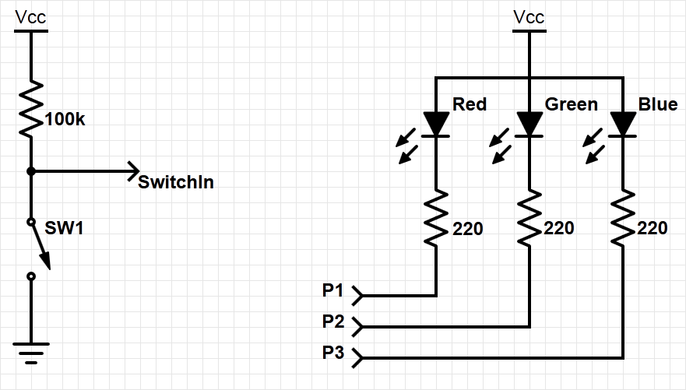

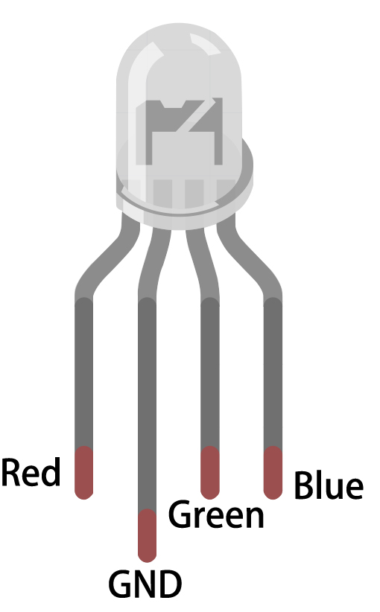
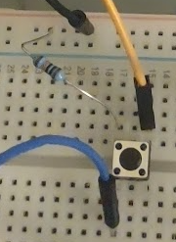
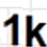
Example system with interrupt
Goal: to change the color of the RGB LED when the switch is pressed
Need to add an external switch
Orange wire to ground
Blue wire to a specified board input
Black wire to 5V
Pressing the button closes the circuit and connects us to ground!
Notes:
Let’s consider the following example:
Using a switch, we want to change the color of an RGB LED when it is pressed. To do this, we apply an external switch to a GPIO pin on the controller. In order to prevent the GPIO pin from being “open”, we will use a pull-up resistor as shown in the slide.
In the following slides, you will see how to implement interrupts by using this example system.

Slide 8
How can we detect when a switch is pressed?
One option is polling; e.g. using software to check it regularly. However, polling is:
Slow – user needs to check to see if switch is pressed
Wasteful of CPU time – the faster the response needed, the more often user needs to check
Not scalable – It’s difficult to build a multi-activity system that can respond quickly. The system’s response time depends on all other processing it has to do.
A better option is an interrupt; e.g., using special hardware in the MCU to detect and run ISR (interrupt service routine) in response. An interrupt is:
Efficient – the code runs only when necessary
Fast – it’s a hardware mechanism
Scalable:
ISR response time doesn’t depend on most other processing
Code modules can be developed independently
Notes:
There are two ways to detect when a switch is pressed or not: polling and use of interrupts.
Polling is the method in which the microcontroller is continuously checking the status of a flag. It is slow, inefficient and is poorly scalable: The more GPIO or other events have to be polled, the more time is needed. So there is a natural limit to the number of supervised GPIOs possible at a given processor speed.
However, an interrupt-based routine only runs the code when it is called/initiated by the internet-service routine. This routine directly executes addressed code, sometimes without any CPU interaction. Therefore it is fully scalable, because it is independent from the number of monitored events, so the supervision doesn’t consume CPU time.

Slide 9
Interrupt or Exception Processing Sequence
Main code is running.
When the interrupt trigger occurs:
The processor does some hardwired processing
The processor executes the ISR, including return-from-interrupt instruction at the end
Then the processor resumes running main code
Hardwired CPU response activities
Interrupt routine
Main code
Time
Notes:
The term “interrupt” is self-explanatory: according to its priority, it interrupts (nearly) everything in order to execute its own code. While each interrupt’s configuration determines what is actually interrupted, if the interrupt is active, then regular program code will be stopped.
After stopping the main code, some hardwired routines such as saving registers are performed, before the interrupt routine is started.
All steps will be reversed after the interrupt routine is finished, and the regular program execution continues.

Slide 10
Interrupts
Hardware-triggered asynchronous software routine
Triggered by hardware signal from peripheral or external device
Asynchronous – can happen anywhere in the program (unless interrupt is disabled)
Software routine – Interrupt Service Routine runs in response to interrupt
Fundamental mechanism of microcontrollers
Provides efficient event-based processing rather than polling
Provides quick response to events regardless of program state, complexity, location
Allows many multithreaded embedded systems to be responsive without an operating system (specifically task scheduler)
Notes:
Interrupts are classified as asynchronous. Asynchronous stands for non-predictable, event-driven, and needs a dedicated trigger.
Therefore, asynchronous controller internal events need to be generated, and these are normally hardware-based pre-processed. In the next step, linked by an internal jump to a dedicated memory area, this code may directly be executed within any significant involvement of the CPU.
This is fundamental for microcontroller programming, because it allows for minimalism, special task design, energy, and runtime sensitivity. So the controller must be prevented from doing unnecessary tasks by operating in a passive mode as long as possible, responding mostly to events and triggers only. Based on this principle, multithreading can be emulated by hardware interrupts without the need for an operating system: The basic operation runs in a main task. Whenever something important happens, this task can be interrupted for a prioritized one.

Slide 11
Example program requirements and design
MAIN
RGB LED
SW
ISR
count
(does initialization, then updates LED based on count)
Global Variable
ISR
MAIN
When switch SW is pressed, ISR will increment count variable.
Main code will light LEDs according to count value in binary sequence (Blue: 4, Green: 2, Red: 1).
Main code will toggle its debug line each time it executes.
ISR will raise its debug line (and lower main’s debug line) whenever it is executing.
Notes:
Going back to our example, the program can be divided into three segments: the main code, the ISR and a global variable.
As shown in the slide, the main code does the initialization, lights the RGB LED according to the global variable value, and toggles the debug line for every loop iteration.
The ISR is triggered only when the switched is pressed and is incrementing the global variable value. The ISR also sets the debug line whenever it is executing.

Slide 12
Interrupts and Low-Power Features
SUPPLEMENTAL CONTENT

Slide 13
Entering exception handler: CPU hardwired exception processing
Finish current instruction
Except for lengthy instructions
Push context (registers) onto current stack (generally our MSP, Main Stack Pointer)
xPSR, Return Address, LR(R14), R12, R3, R2, R1, R0
Switch to handler/privileged mode, use MSP
Load PC with address of interrupt handler
Load LR with EXC_RETURN code
Load Interrupt Program Status Register (IPSR) with exception number
Start executing code of interrupt handler
Usually 16 cycles from exception request to execution of first instruction in handler
Notes:
After the exception is triggered, the current instruction (unless it is a lengthy instruction) of the operating code finishes before the interrupt execution process starts. From here within 16 cycles (also called “interrupt latency”), first the current architectural state is saved onto the stack, and then the interrupt routine is prepared (load PC). Afterwards, the return address stored in the LR and the IPSR is loaded with the correct exception number to be executed. Now the interrupt code is started.
Steps are explained in the following slides.

Slide 14
1. Finish current instruction
Most instructions are short and finish quickly.
Some instructions may take many cycles to execute.
Load Multiple (LDM), Store Multiple (STM), Push, Pop, MULS (32 cycles for some CPU core implementations)
This will delay interrupt response significantly.
If one of these is executing when the interrupt is requested, the processor:
abandons the instruction
responds to the interrupt
executes the ISR
returns from interrupt
restarts the abandoned instruction
Notes:
Exception entry occurs when there is a pending exception with sufficient priority, and either the processor is in Thread mode, or the new exception is of higher priority than the exception being handled, in which case the new exception preempts the original exception. If the current executing instruction takes many cycles to execute, then the instruction is abandoned and is restarted after the ISR execution.

Slide 15
2. Push context onto current stack
 |  | <previous> | SP points here before interrupt
 | SP + 0x1C | xPSR
 | SP + 0x18 | PC
Decreasing | SP + 0x14 | LR
memory | SP + 0x10 | R12
address | SP + 0x0C | R3
 | SP + 0x08 | R2
 | SP + 0x04 | R1
 | SP + 0x00 | R0 | SP points here upon entering ISR
Two SPs: Main (MSP), process (PSP)
Which is active depends on operating mode, CONTROL register bit 1
Stack grows toward smaller addresses
Notes:
Alike calling a subroutine, the processor pushes information onto the current stack (PC, xPSR, LR, and registers) before beginning to execute the exception code. The operation of pushing content to the stack is called stacking, whereas the structure of the eight words is called a stack frame.
After the termination of the routine it will be restored and continued from this point.

Slide 16
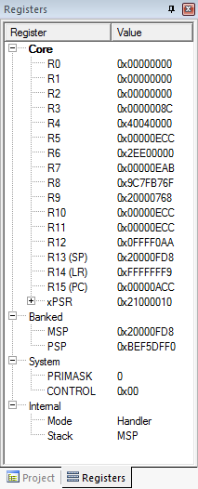
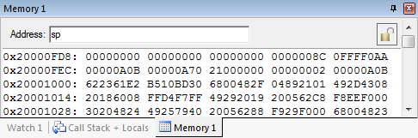
Context saved on stack
SP value is reduced since registers have been pushed onto stack
Saved R0
Saved R1
Saved R2
Saved R3
Saved R12
Saved LR
Saved PC
Saved xPSR
Notes:
The memory snapshot shows the saved registers on the stack. Each word in the stack now holds the value of each one of the registers that are pushed in the stack (stack frame).

Slide 17
3. Switch to handler/privileged mode
Handler mode always uses Main SP
Reset
Thread
Mode. MSP or PSP.
Exception Processing
Completed
Starting Exception Processing
Handler Mode
MSP
Notes:
After saving the registers and before executing the ISR-code, the execution of the exception needs to be prepared. To do this, the code execution must be switched into privileged mode, so the processor has more access to the core functions, such as full access to the MSR, the MRS instructions, the CPS instructions, and access the system timer, NVIC, or system control block.
This needs to be reversed again after finishing the exception code and returning to normal operation.

Slide 18
4. Load PC with address of exception handler
Memory Address | Value
0x0000_0000 | Initial Stack Pointer
0x0000_0004 | Reset
0x0000_0008 | NMI_IRQHandler
…
 | IRQ0_Handler
 | IRQ1_Handler
…
Reset:
…
NMI_IRQHandler:
…
IRQ0_Handler:
…
IRQ1_Handler:
Which Program Counter is selected from the vector table depends on which exception is used
Notes:
When an exception is triggered, the Program Counter is loaded with the corresponding exception handler code according to the exception handler type, which can be found on the vector table.

Slide 19
5. Load LR with EXC_RETURN code
EXC_RETURN value generated by CPU to provide information on how to return
Which SP to restore registers from? MSP (0) or PSP (1)
Which mode to return to? Handler (0) or Thread (1)
Another exception handler may have been running when this exception was requested
EXC_RETURN | Return Mode | Return Stack | Description
0xFFFF_FFF1 | 0 (Handler) | 0 (MSP) | Return to exception handler
0xFFFF_FFF9 | 1 (Thread) | 0 (MSP) | Return to thread with MSP
0xFFFF_FFFD | 1 (Thread) | 1 (PSP) | Return to thread with PSP
Notes:
When stacking is complete, the processor starts executing the exception handler. At the same time, the processor writes an EXC_RETURN value to the LR. This indicates which stack pointer corresponds to the stack frame, and what operation mode the processor was in before the entry occurred.

Slide 20
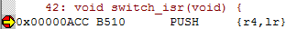
6. Start executing exception handler
Exception handler starts running, unless preempted by a higher-priority exception
Exception handler may save additional registers on stack
E.g. if handler may call a subroutine, LR and R4 must be saved
Notes:
Now the exception code has started executing. If nested interrupts are allowed, this can be stopped by another, higher priority interrupt. Otherwise, nested interrupts may also be prohibited. In that case, only high priority exceptions, such as a reset or watchdog event, may interrupt this code.

Slide 21
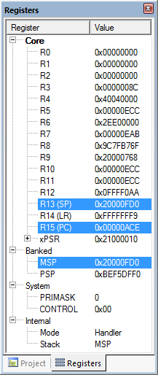
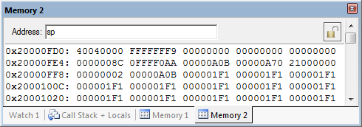
After handler has saved more context
Saved R4
Saved LR
Saved R0
Saved R1
Saved R2
SP value reduced since registers have been pushed onto stack
Saved R3
Saved R12
Saved LR
Saved PC
Saved xPSR
Notes:
Now additional code has been executed, and registers values have been pushed to the stack.

Slide 22
Exiting an exception handler
Execute instruction triggering exception return processing
Select return stack, restore context from that stack
Resume execution of code at restored address
Notes:
Exception return occurs when the processor is in Handler mode and loads the EXC_RETURN value into the PC, in order to restore context and resume execution of the main code.

Slide 23
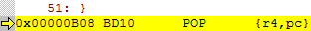
1. Execute instruction for exception return
No “return from interrupt” instruction
Use regular instruction instead
BX LR - Branch to address in LR by loading PC with LR contents
POP …, PC - Pop address from stack into PC
… with a special value EXC_RETURN loaded into the PC to trigger exception handling processing
BX LR used if EXC_RETURN is still in LR
If EXC_RETURN has been saved on stack, then use POP
Notes:
There is no special instruction for returning from interrupt. The interrupt routine is terminated like a regular branch.
Depending on where the return address has been stored, either BX LR is used if the return address is still in LR, or the return address has been stored on the stack and is recalled with POP.

Slide 24
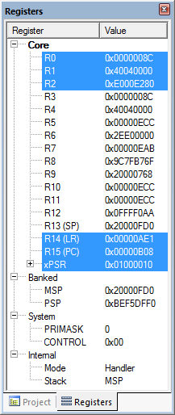
What will be popped from stack?
R4: 0x4040_0000
PC: 0xFFFF_FFF9
Saved R4
Saved LR
Saved R0
Saved R1
Saved R2
Saved R3
Saved R12
Saved LR
Saved PC
Saved xPSR
Notes:
Initially, R4 and PC will be popped from the stack. PC will be loaded with the EXC_RETURN code.

Slide 25
2. Select stack, restore context
Check EXC_RETURN (bit 2) to determine from which SP to pop the context
Pop the registers from that stack
EXC_RETURN | Return Stack | Description
0xFFFF_FFF1 | 0 (MSP) | Return to exception handler with MSP
0xFFFF_FFF9 | 0 (MSP) | Return to thread with MSP
0xFFFF_FFFD | 1 (PSP) | Return to thread with PSP
 |  | <previous> | SP points here after handler
 | SP + 0x1C | xPSR
 | SP + 0x18 | PC
Decreasing | SP + 0x14 | LR
memory | SP + 0x10 | R12
address | SP + 0x0C | R3
 | SP + 0x08 | R2
 | SP + 0x04 | R1
 | SP + 0x00 | R0 | SP points here during handler
Notes:
If the return mode is set to “handler”, the controller may execute another interrupt, otherwise it returns to the normal program execution.
Returning into the normal thread mode, the next step is to determine from which stack (MSP or PSP) the data should be restored. This decision is mainly made to prevent the main program from running out of stack space. As seen on previous slides, the stack is defined by the second bit of the EXC_RETURN: if 0 then the information is in the MSP, if 1 then it is in the PSP.

Slide 26
Example
PC=0xFFFF_FFF9, so return to thread mode with main stack pointer
Pop exception stack frame from stack back into registers
Saved R0
Saved R1
Saved R2
Saved R3
Saved R12
Saved LR
Saved PC
Saved xPSR
Notes:
In this example, according to the EXC_RETURN code, we are going to return to thread mode with the main stack pointer and pop stack frame back to registers.

Slide 27
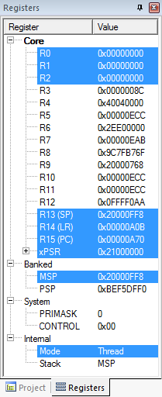
3. Resume executing previous main thread code
Exception handling registers have been restored: R0, R1, R2, R3, R12, LR, PC, xPSR
SP is back to previous value
Back in thread mode
Next instruction to execute is at 0x0000_0A70
Notes:
Finally, all exception handling registers have been restored (R0, R1, R2, R3, R12, LR, PC, xPSR), and the stack point (SP) points to the value before the interrupt execution. The thread mode is active again, and the PC points to the next regular code instruction at 0x0000_0a70.
The system is in the same Execution state as before the interrupt.

Slide 28
Microcontroller interrupts
Types of interrupts:
Hardware interrupts
Asynchronous: not related to what code the processor is currently executing
Examples: interrupt is asserted, character is received on serial port, or ADC converter finishes conversion
Exceptions, faults, software interrupts
Synchronous: are the result of specific instructions executing
Examples: undefined instructions, overflow occurs for a given instruction
We can enable and disable (mask) most interrupts as needed (maskable), others are non-maskable
Interrupt service routine (ISR)
Subroutine which processor is forced to execute to respond to a specific event
After ISR completes, MCU goes back to previously executing code
Notes:
There are different types of interrupts: primarily “regular” and “exceptional” interrupts.
Regular interrupts are based on asynchronous external events; for example, they are created by ADC conversions, or data received at serial ports. Exceptions usually occur synchronously, which means they are the result of undesirable behavior of executed instructions. Because they happen at the same time as the code, they are called “synchronous”.
Most interrupts can be masked; that is, they can be disabled. The term “masked” comes from the bit mask which is defined to filter unneeded or unwanted interrupts. But not all interrupts are maskable; for example, the watchdog interrupt is not maskable. In this case, they are called non-maskable interrupt (NMI).
The code being forced to be executed by an interrupt is called interrupt service routine (ISR).

Slide 29
Interrupt response latency
Latency = time delay
Why do we care?
This is overhead which wastes time, and increases as the interrupt rate rises.
This delays our response to external events, which may or may not be acceptable for the application, such as sampling an analog waveform.
How long does it take?
Finish executing the current instruction or abandon it
Push various registers on to the stack, fetch vector
C_{IntResponseOvhd}: Overhead for responding to each interrupt
If we have external memory with wait states, this takes longer
Notes:
A very important aspect of interrupts is “latency”.
Latency is defined as the time delay between when the interrupts are triggered, and when the interrupt service routine begins to execute. In some applications, latency is critical; for example, when an analog waveform is sampled.
There are several side-effects that can affect latency, which has to be taken into consideration. For example, latency is affected if the current executing instruction is finished or abandoned.

Slide 30
Maximum interrupt rate
We can only handle so many interrupts per second
F_{Max_Int}: maximum interrupt frequency
F_{CPU}: CPU clock frequency
C_{ISR}: Number of cycles ISR takes to execute
C_{Overhead}: Number of cycles of overhead for saving state, vectoring, restoring state, etc.
F_{Max_Int} = F_{CPU}/(C_{ISR}+ C_{Overhead})
Note that model applies only when there is one interrupt in the system
When processor is responding to interrupts, it isn’t executing our other code
U_{Int}: Utilization (fraction of processor time) consumed by interrupt processing
U_{Int} = 100%*F_{Int}* (C_{ISR}+C_{Overhead})/ F_{CPU}
CPU looks like it’s running the other code with CPU clock speed of (1-U_{Int})*F_{CPU}
Notes:
The maximum interrupt frequency equals the CPU clock frequency, divided by the sum of the interrupt service routine, plus the interrupt overhead cycles.
Note that the higher the interrupt frequency, the less the less time there is for the CPU to execute other code.

Slide 31
Program design with interrupts
How much work to do in ISR?
Trade-off: faster response for ISR code will delay completion of other code
In system with multiple ISRs with short deadlines, perform critical work in ISR and buffer partial results for later processing
Should ISRs re-enable interrupts?
How to communicate between ISR and other threads?
Data buffering
Data integrity and race conditions
Volatile data – can be updated outside of the program’s immediate control
Non-atomic shared data – can be interrupted partway through read or write, is vulnerable to race conditions
Notes:
We have to take several design-time decisions, related to the interrupt implementation, when we are we are designing a program with interrupts.
First, we must consider the amount of work that will be assigned to an interrupt. We have to deal with the time that is going to be spent in between ISR and other code. If we have multiple ISRs, it is better to assign them to perform only critical work, and to buffer the rest for later processing.
Another important question is whether ISRs should be in charge to re-enable interrupts? Because we do not want to have an ISR running for long with all interrupts disabled, it might be preferable for a long-running ISR to re-enable interrupts. On the other hand, if an ISR is fast and efficient, then there is no need for such action.
One way to communicate between ISR and other code is software data buffering, which is generally used as a communication interface. We must always keep data integrity and race conditions in mind.

Slide 32
Examining the problem more closely
Protect any data object which both:
Requires multiple instructions to read or write (non-atomic access), and
Is potentially written by an ISR
How many tasks/ISRs can write to the data object?
If one, then we have one-way communication
Must ensure the data isn’t overwritten partway through being read
Writer and reader don’t interrupt each other
If more than one, we
Must ensure the data isn’t overwritten partway through being read
Writer and reader don’t interrupt each other
Must ensure the data isn’t overwritten partway through being written
Writers don’t interrupt each other
Notes:
The data that have to be protected are those which are potentially changed by an ISR, and require multiple instructions to read or write (non-atomic access).
There are many boundary conditions to be met. For instance, if only ISR/task writes to a data object, then we must ensure that data is not overwritten partway through being read. Consequently, writer and reader should not interrupt each other. Additionally, in the case of multiple ISRs that can write to data object, then we have to ensure that writers don’t interrupt each other as well.

